Slide 1

CVR COLLEGE OF ENGINEERING (An Autonomous Institution, NAAC Accredited and Affiliated to JNTU, Hyderabad) Vastunagar, Mangalpalli (V), Ibrahimpatnam (M), Rangareddy (D), Telangana- 501 510 DEPARTMENT OF CSE (DATA SCIENCE) B.Tech II Year II Semester Real-Time/Field - Based Research Project Review - I

Slide 2
CLOUD BURST IDENTIFICATION AND WEATHER ANOMALY ANALYSIS
By
R. Sri Harini (24B81A67H6)
V. Uday Durga (24B81A67J3)
P. Varshini (24B81A67J5)
Under the guidance of
Dr.Yasmeen
Sr. Assistant Professor
CSE (Data Science)

Slide 3
Abstract
Extreme weather like cloud bursts is a huge problem lately. Our project, Cloud Burst Identification and Weather Anomaly Analysis, tracks these events using a data-driven approach instead of IoT sensors. We use Python and SQL to monitor rainfall, temperature, and humidity. If rainfall hits a specific threshold, the system flags it as a cloud burst. We’ve also added 7-day trend analysis, heatmaps, and an automatic PDF report generator. Our web dashboard even changes color based on alert levels to make monitoring simple and visual.
Keywords
Weather Anomaly: Detecting unusual climatic shifts.
Threshold Identification: Spotting cloud bursts via rainfall limits.
Data Analysis: Processing trends using Python & SQL.
Visualization: Heatmaps and automated PDF reporting.
Risk Zoning: Mapping geographical weather risks.

Slide 4
Introduction
Our project, Cloud Burst Identification and Weather Anomaly Analysis, monitors these events using a simple, data-driven approach. Instead of using expensive sensors or ML, we use Python and SQL to analyze rainfall, temperature, and humidity. By comparing real-time data against historical thresholds, the system detects anomalies instantly.
We will also built a web dashboard with heatmaps and 7-day trends that changes color based on alert levels. It even generates daily PDF reports, making extreme weather tracking easy and accessible for everyone.

Slide 5
Literature Survey
S.No | Author/Year | Focus Area | Key Idea
1 | Sharma et al. (2023) | Cloudburst Prediction (AI) | Uses ML with satellite data to predict cloudburst events.
2 | Reddy et al. (2022) | Hybrid ML Models | Combines Random Forest & LSTM for better rainfall prediction.
3 | Kumar et al. (2021) | Weather Anomaly Detection | Detects unusual weather patterns using time-series data.
4 | Singh et al. (2020) | IoT Weather Monitoring | Collects real-time temperature & humidity data.
5 | Patel et al. (2023) | Deep Learning Models | Uses CNN & LSTM for large weather datasets.
6 | Verma et al. (2022) | Remote Sensing | Analyzes satellite images for rainfall conditions.
7 | Gupta et al. (2021) | Anomaly Detection | Uses Isolation Forest & SVM for abnormal weather detection.
8 | Das et al. (2024) | Real-Time Alerts | Provides early warning for extreme weather events.

Slide 6
Drawbacks of Existing Methods:
Low Accuracy – Many ML models fail during extreme or sudden weather changes.
High Data Dependency – Require large, high-quality historical datasets.
Limited Real-Time Processing – Some systems cannot give instant alerts.
High Cost – Satellite & IoT infrastructure is expensive.
Complex Implementation – Hybrid and deep learning models need high computational power.
Location-Specific – Models trained for one region may not work well in other areas.
False Alarms – Anomaly detection systems sometimes generate incorrect warnings.

Slide 7
Problem Statement
Weather is becoming more unpredictable, and sudden cloud bursts are causing massive damage like floods and landslides. The main problem is that most current weather systems are either too expensive because they require IoT sensors or too complex because they use Machine Learning. This makes it hard for local authorities to have a simple, low-cost way to monitor risks in real-time. Also, raw weather data is often confusing, so there is a huge need for a system that can automatically detect anomalies and present them through clear alerts and visual reports.

Slide 8
Proposed System
Our proposed project is a data-driven system that uses Python and SQL to identify cloud bursts by comparing rainfall against specific thresholds. It features a smart web dashboard with color-coded alerts and automated reports to make weather monitoring simple and effective.
Logic-Based Detection: Uses rainfall thresholds and historical averages instead of ML or sensors.
Trend Visualization: Includes 7-day moving averages and district-wise heatmaps to track patterns.
Dynamic Dashboard: An HTML interface that changes color based on real-time alert levels.
Automated Reporting: Generates daily PDF summaries with risk indexes and anomaly data.
Risk Zoning: Uses static maps to highlight areas most prone to extreme weather.

Slide 9
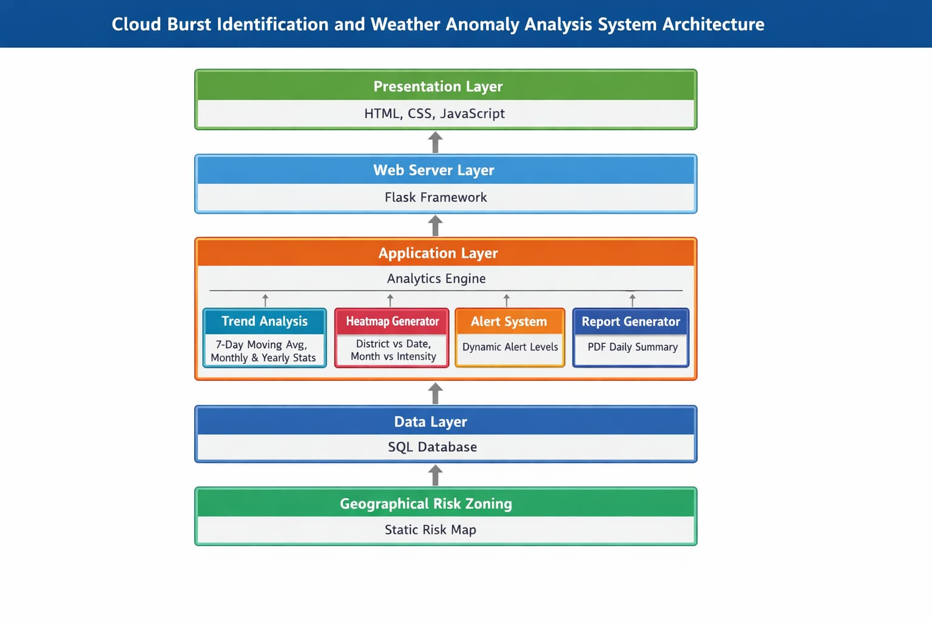
System Architecture

Slide 10
List of Modules/Features
Trend & Rainfall Analysis
Cloudburst & Anomaly Detection
Dynamic Alert System
Heat Map & Risk Zoning
Automatic PDF Report Generation

Slide 11
Technology Stack
Software Requirements:
Programming Languages : Python, HTML &CSS
Database Management : MySQL/ SQL
Development Tools (IDEs) : VSCode, Jupyter Notebook
Hardware Requirements:
Processor: Intel i5 or equivalent AMD processor (Fast enough to run our Python logic and SQL queries).
RAM: 4 GB Minimum (To handle data visualization and the web dashboard smoothly).
Storage: 256 GB (To store our SQL database and the generated PDF reports).
Operating System: Windows 10/11 or Linux.

Slide 12
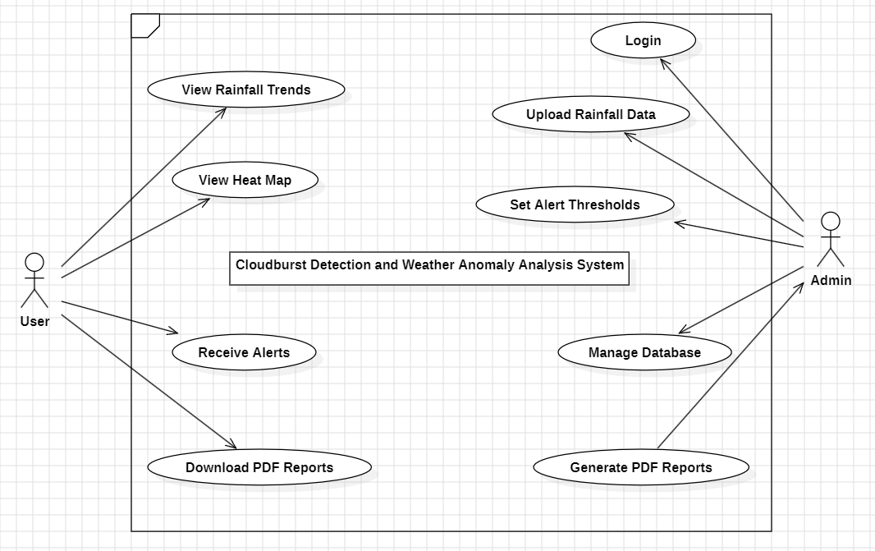
Use-Case Diagram

Slide 13
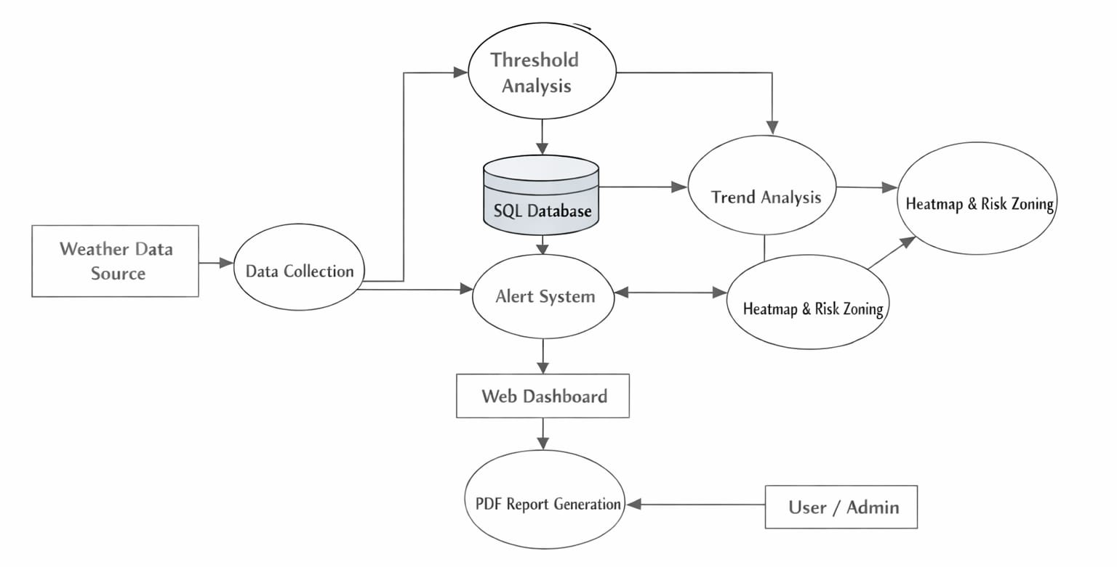
Data Flow Diagram

Slide 14
References
PDF generation for Python
fpdf · PyPI
MySQL Documentation – Oracle Corporation.
Cloudburst-disaster modelling
Cloudburst-disaster modelling. A new open-source catastrophe model – ScienceDirect
Flask
Welcome to Flask — Flask Documentation (3.1.x)

Slide 15
Thank You

